Slide 1
CHOOSING INTENTIONALLY INCLUSIVE CONTENT
Using the online shift to sneak it in. Shh!

Slide 2
REPRESENTATION MATTERS
"It doesn't matter what age you are, you still need a character you can connect with" -Marley Dias
Article about Marley Dias

Slide 3
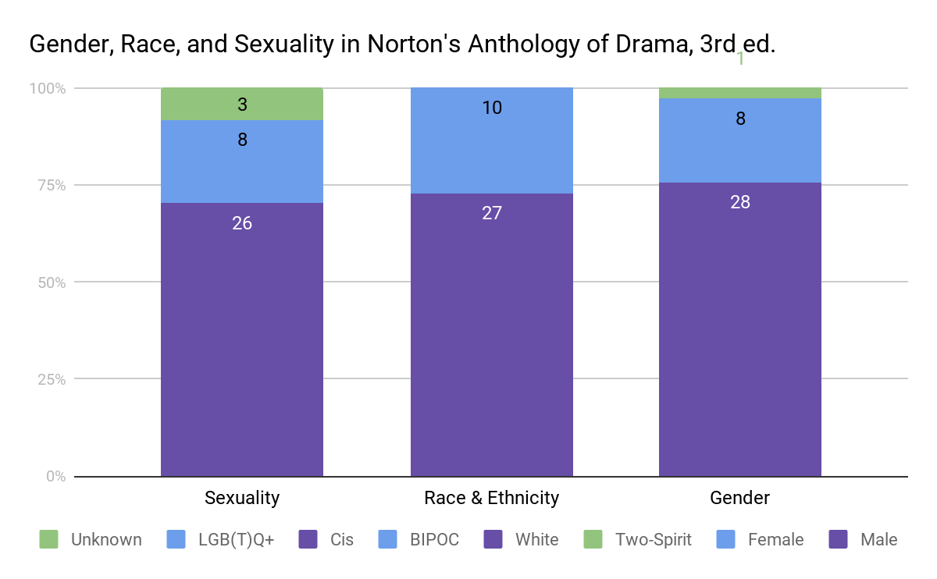
STEP ONE:
REFLECTING ON YOUR CURRENT COURSE CONTENT

Slide 4
STEP TWO:
BUILDING CONVERSATIONS AROUND COURSE CONTENT
How can you supplement the things you can’t get rid of?
Critiques of the works by and about marginalized communities.
Intersectional Discussions. How are economic opportunities impacted by race or gender?
Highlighting the contributions of marginalized people to your field.

Slide 5
STEP THREE:
USING THE INTERNET TO YOUR ADVANTAGE: VIDEO
TED Talks - “The new bionics that let us run climb and dance” Hugh Herr discusses his nature-inspired designs for the next generation of bionic limbs and his experience with his own bionic legs, with a special performance of a dancer who lost her leg in the Boston Marathon Bombings dancing on stage for the first time.
YouTuber: Philosophy Tube - A personal favorite of mine, although very political, with over-the-top videos on topics like “Witchcraft, Gender, & Marxism” the nature of the modern British monarchy, and capitalism’s influence on the video game industry.

Slide 6
STEP THREE:
USING THE INTERNET TO YOUR ADVANTAGE: PODCASTS
The Allusionist - How language reflects sociocultural shifts. The “East/West” episode, transcript linked here, looks at lost languages of postwar East Berlin
Side Door - “This Color Is Who I Am” linked here, examines the AIDS/HIV crisis through the eyes of an artist who lived through it.
Dolly Parton’s America - “Dixie Disappearance” linked here discusses the current debate over Civil War memorials and white-washing history through the lens of a Dollywood dinner theatre.

Slide 7
SOME WARNINGS:
Be careful not to “tokenize” someone’s experience.
Dive into why we have different experiences, not just what they are.
Listen to your student’s responses, but again don’t “tokenize.”
Not everyone comes to the table at the same level, be willing to start from the ground up in respectful ways.

Slide 8
“Only acknowledging the experiences of African American students during Black History Month and compartmentalizing underrepresented student experiences into one “diversity course” or single class unit treats them as “addon” topics to the curriculum. These practices tokenize students from different cultural backgrounds and diminish student learning.
Faculty cannot depend exclusively on the course content to which they were exposed during graduate school. Instead, they must hold themselves accountable for introducing new literature to which they might be unaccustomed in order to enable students to understand differences”
-Faculty Accountability for Culturally Inclusive Pedagogy and Curricula

